Slide 1



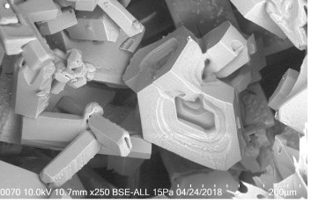

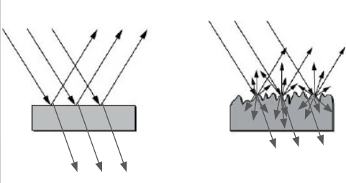
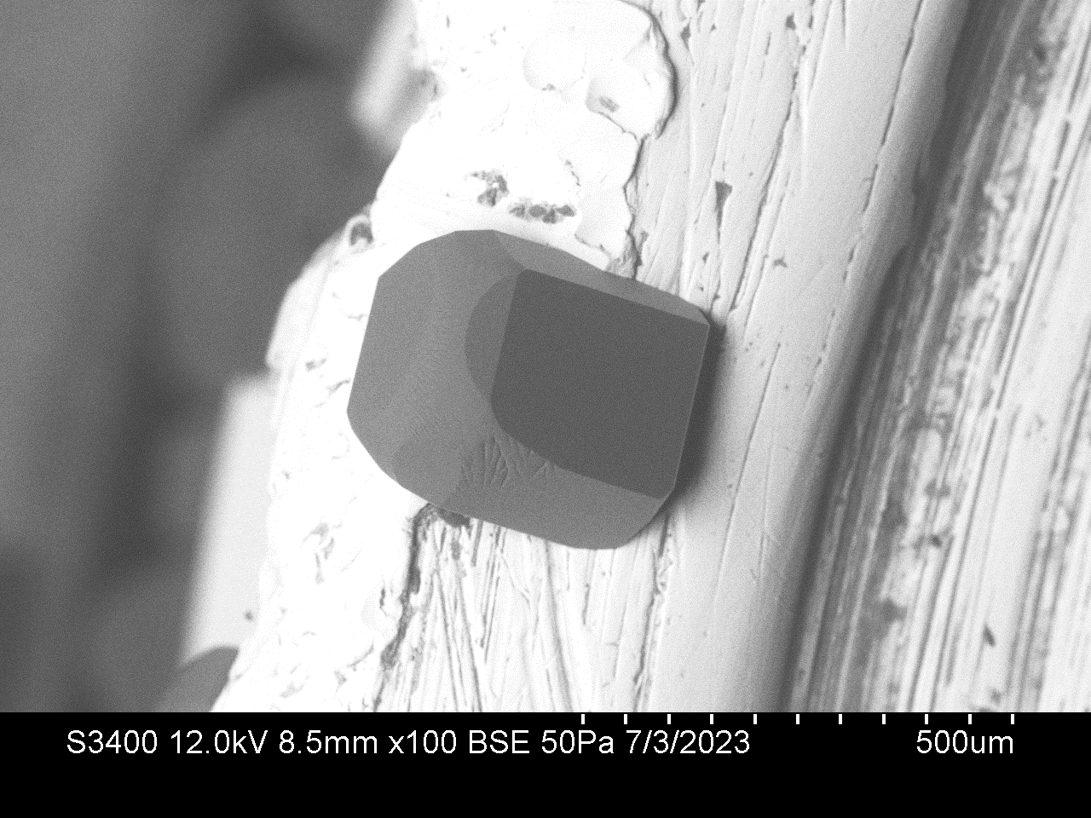
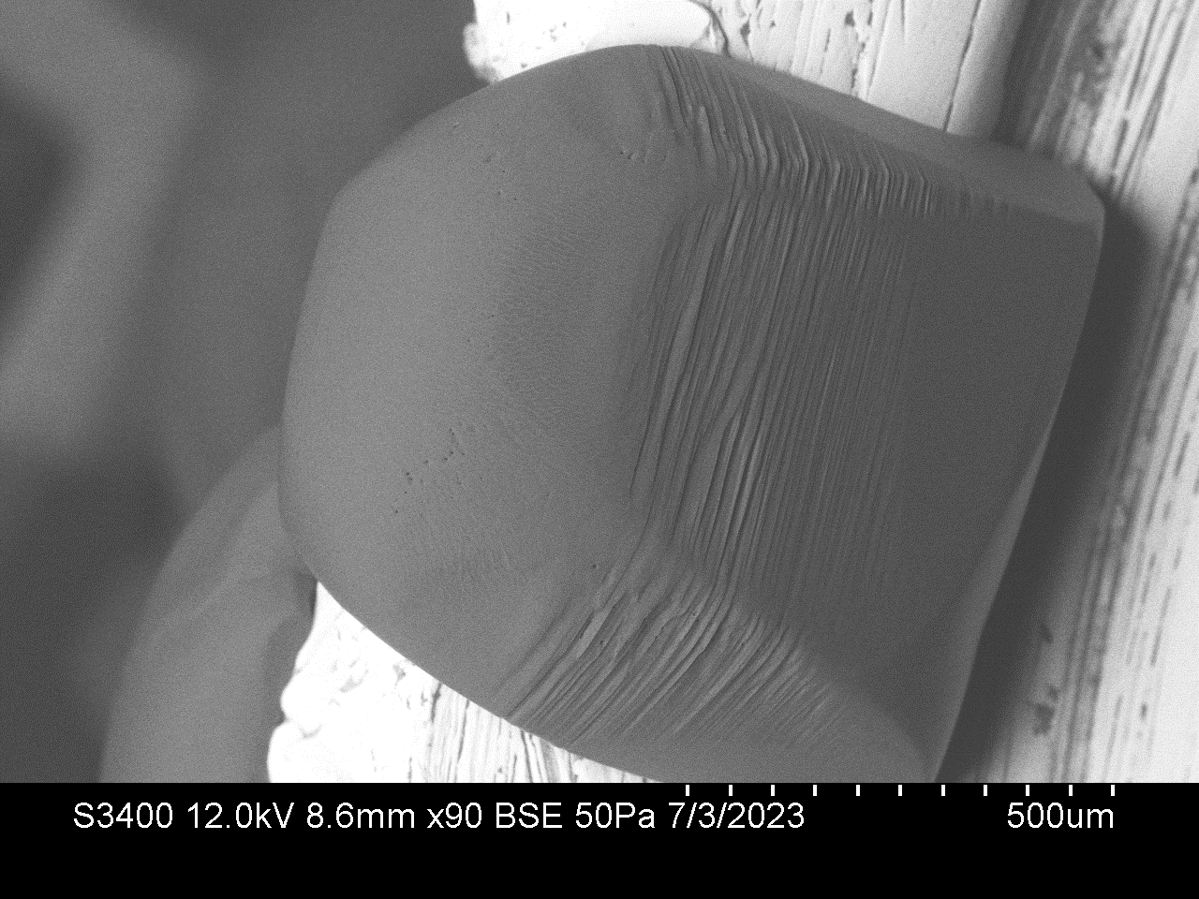
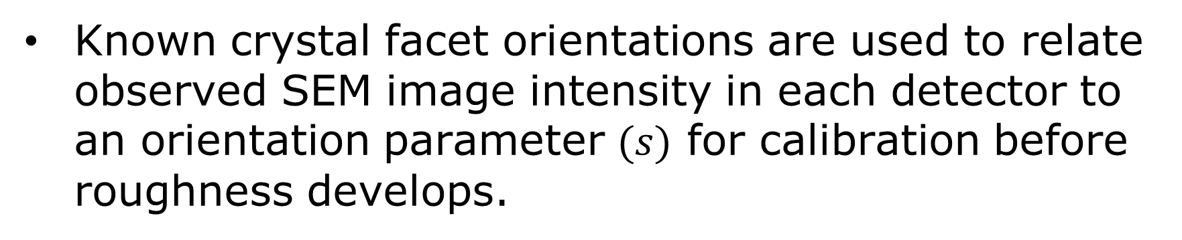
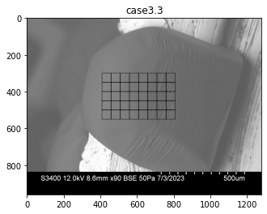
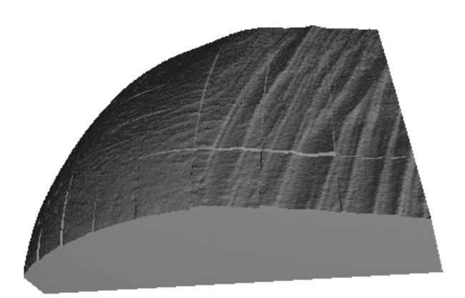
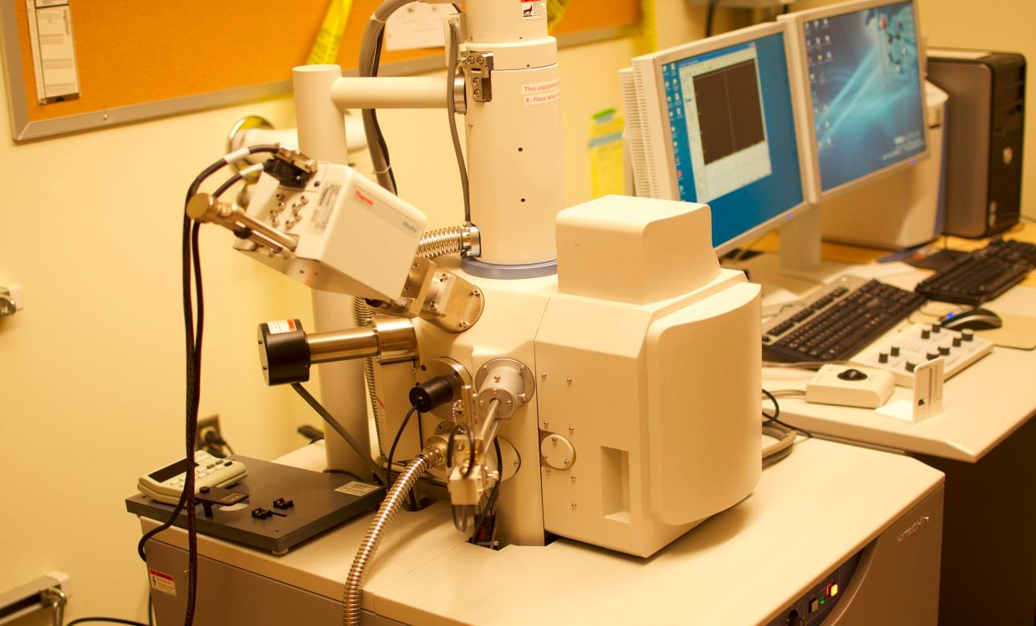
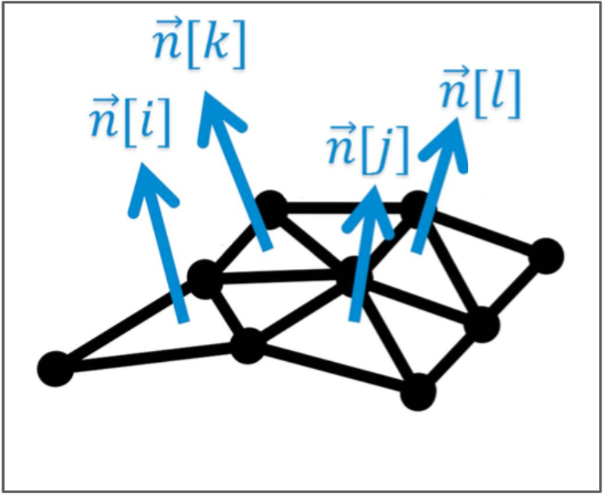
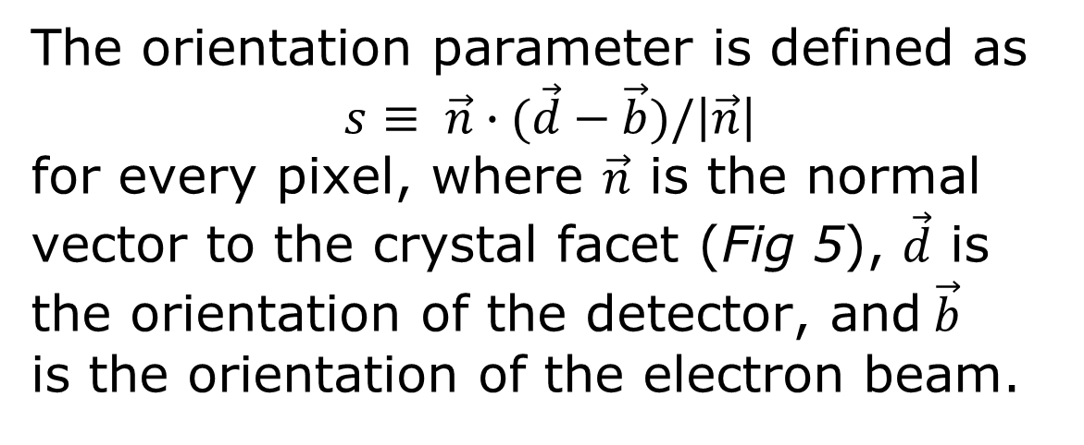
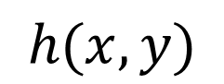
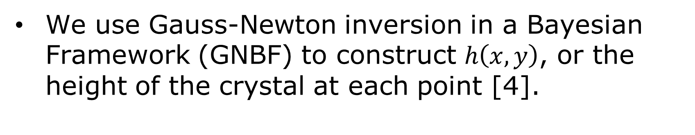
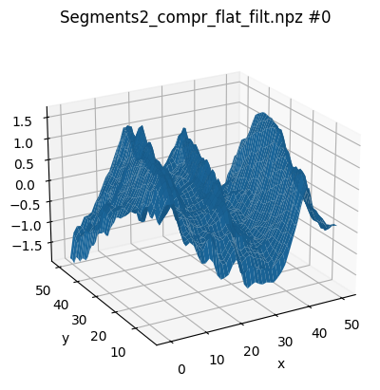
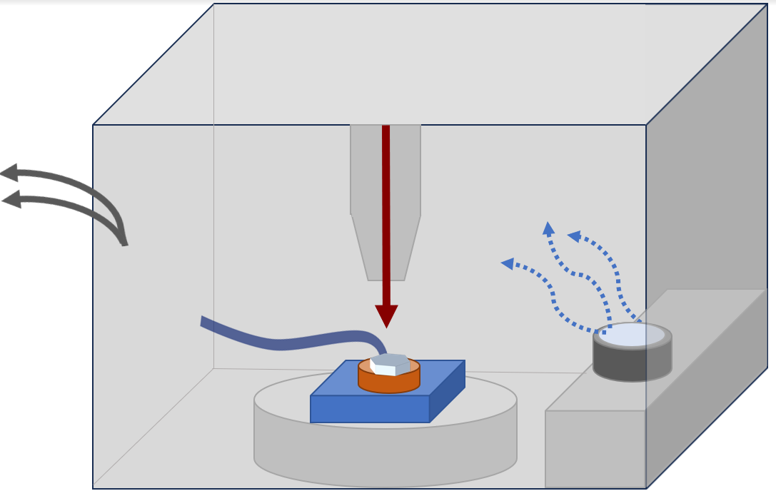
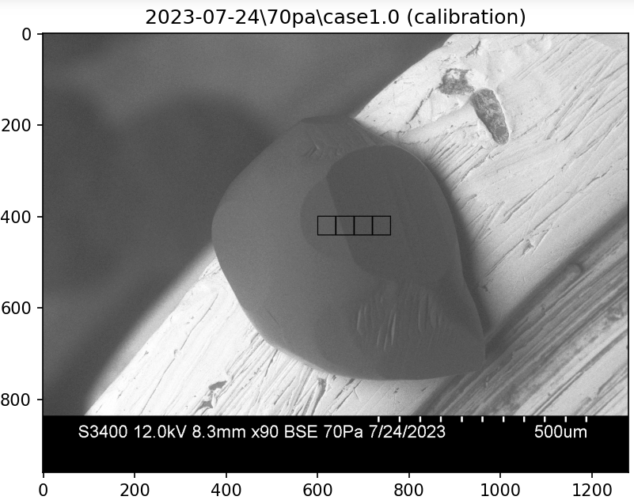
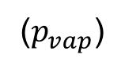
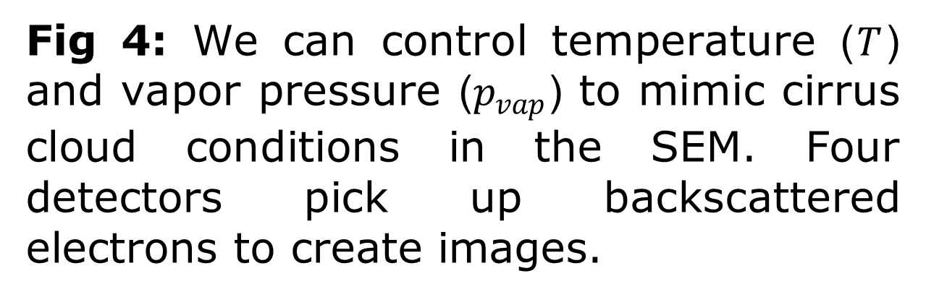
Characterizing the roughness of cirrus cloud ice crystals
Part 1
Tia Böttger, Rohan Crossland, Jake Price, Steven Neshyba; University of Puget Sound, Department of Mathematics
Introduction
Research Questions
High altitude cirrus clouds (Fig 1) cover about 30% of the globe, and 60-70% of tropics [1,2].
They both absorb and reflect infrared and solar radiation, regulating Earth’s climate.
Radiative properties of cirrus clouds are determined by the features of the ice crystals that compose them (Fig 2).
Roughness has been shown to develop on ice crystal facets, increasing their reflectivity (Fig 3).
Even within one cloud, ice crystals exhibit diverse morphologies, largely due to changing temperature and vapor pressure conditions.
A detailed understanding of ice crystal roughness in different conditions is necessary to reduce uncertainty in climate models.
Cirrus clouds
What is roughness in cirrus cloud ice crystals?
How can we quantify roughness (height, frequency, etc.)?
How does roughness develop as temperature changes?
At different pressures?
Is there a quantitative difference between growth roughness and ablation roughness?
Big picture: What does this imply for the optical properties of crystals in different conditions within cirrus clouds?
Fig 2: Cirrus clouds are composed of ice crystals (primarily hexagonal) [3].
Smooth
Rough
Assumptions and Hypotheses
Less light transmitted
basal
pyramidal
basal
pyramidal
The ice crystals grown in Scanning Electron Microscope (SEM) are a good proxy for those in cirrus clouds.
As crystals ablate (shrink), roughness ridges become scalloped. We predict smaller k values (ridges more spaced out) during ablation as a result.
Stratus cloud deck
prismatic
prismatic
We can control temperature and vapor pressure to mimic cloud conditions.
Fig 1: The wispy appearance of high altitude, ice-containing cirrus clouds contrasts that of liquid-containing clouds (e.g. stratus).
Fig 3: Roughness that develops on crystal facets (seen here on prismatic facet) affects light scattering.
Experimental Methods
Surface Retrieval
Ice crystals are imaged in a Hitachi S-3400N Variable Pressure Scanning Electron microscope (Fig 4).
As the temperature drops, water vapor is released from a sample of ice within the SEM chamber.
Water vapor sublimates into ice crystals on a copper stub on the cold stage.
Vapor pressure is set to remain constant, with separate trials at 30, 50, 70, and 90 Pa.
Temperature is raised by 2ºC every 2 min (within the range -38 to -20ºC) replicating rising temperatures as ice crystals fall in cirrus clouds (Fig 7).
Four detectors pick up backscattered electrons to image crystals.
Reconstruction of retreived segments
Fig 5.
Once calibration is complete, the same crystal can be analyzed in subsequent stages of development.
We retrieve segments of roughened surfaces to analyze roughness.
Scanning Electron Microscope (SEM)
Electron Beam
Water vapor
We verify our calibration by retrieving the angle between two facets, in this case the prismatic and pyramidal. This angle is known to be 28º. The angle between segment 1 and 4 here is given as 27.8 after retrieval (Fig 6).
Vacuum pump
Backscattered electrons
Retrieval of a single segment
Cold Stage
Ice
Fig 6.
(T )
References and Acknowledgments
We acknowledge support from the National Science Foundation (1807898, 2021213), Matelich Challenge Grant, Adam S. Goodman Endowed Student Research Fund, and University Enrichment Committee.
[1] J. Voigtländer et al., “Surface roughness during depositional growth and sublimation of ice crystals,” Atmospheric Chemistry and Physics, vol. 18, no. 18, pp. 13687–13702, 2018, doi: 10.5194/acp-18-13687-2018.
[2] D. Wylie, D. L. Jackson, W. P. Menzel, and J. J. Bates, “Trends in Global Cloud Cover in Two Decades of HIRS Observations,” Journal of Climate, vol. 18, no. 15, pp. 3021–3031, Aug. 2005, doi: 10.1175/JCLI3461.1.
[3] N. B. Magee, A. Miller, M. Amaral, and A. Cumiskey, “Mesoscopic surface roughness of ice crystals pervasive across a wide range of ice crystal conditions,” Atmospheric Chemistry and Physics, vol. 14, no. 22, pp. 12357–12371, Nov. 2014, doi: 10.5194/acp-14-12357-2014.
[1] N. Butterfield, P. M. Rowe, E. Stewart, D. Roesel, and S. Neshyba, “Quantitative three-dimensional ice roughness from scanning electron microscopy,” Journal of Geophysical Research: Atmospheres, vol. 122, no. 5, pp. 3023–3041, 2017, doi: 10.1002/2016JD026094.
Continue in Part 2…

Slide 2
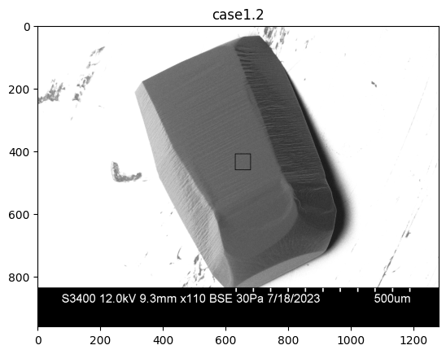
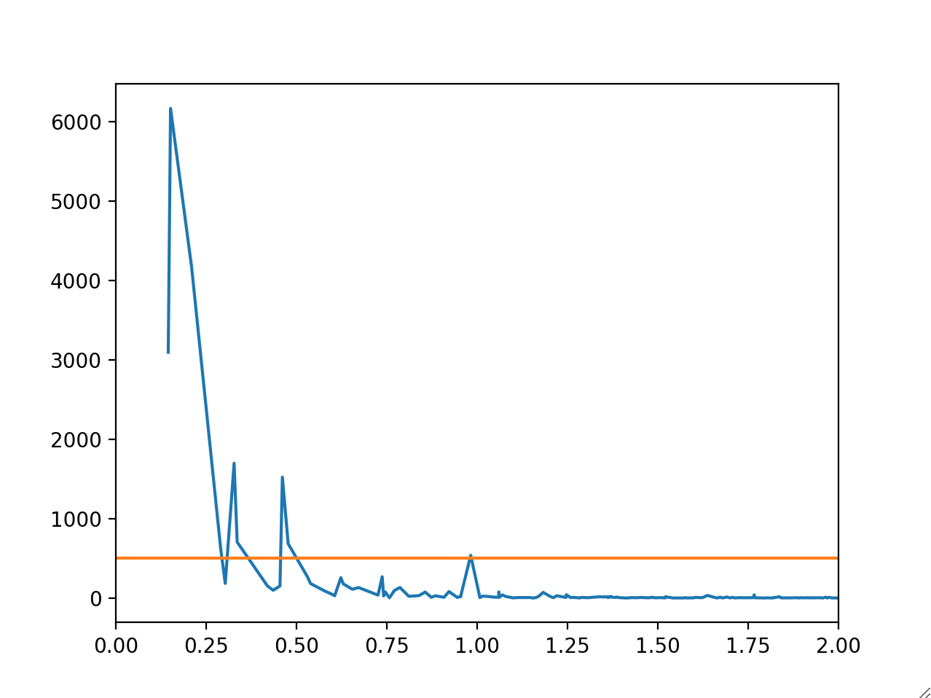
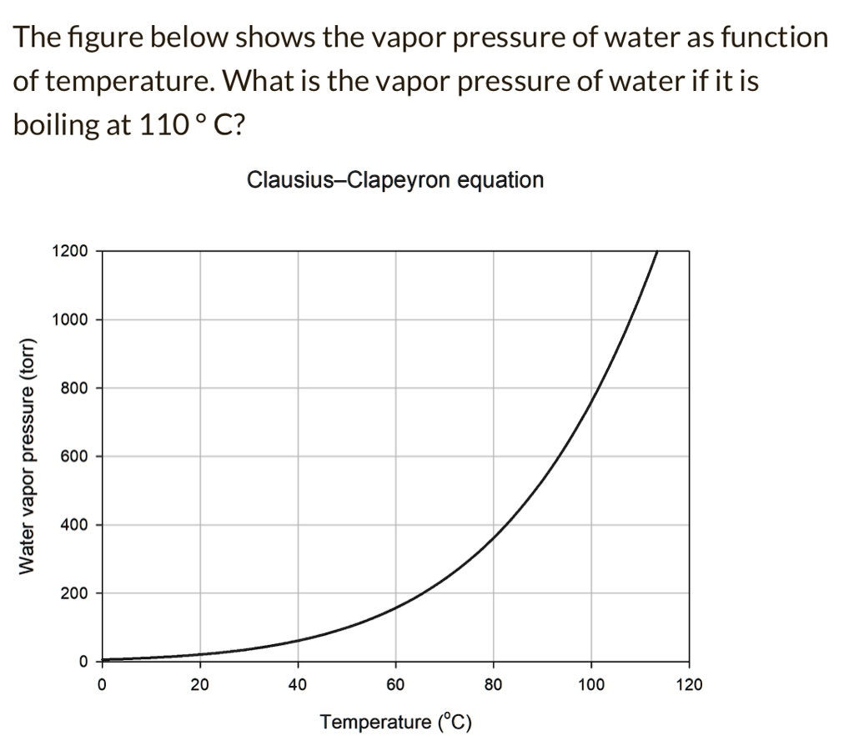

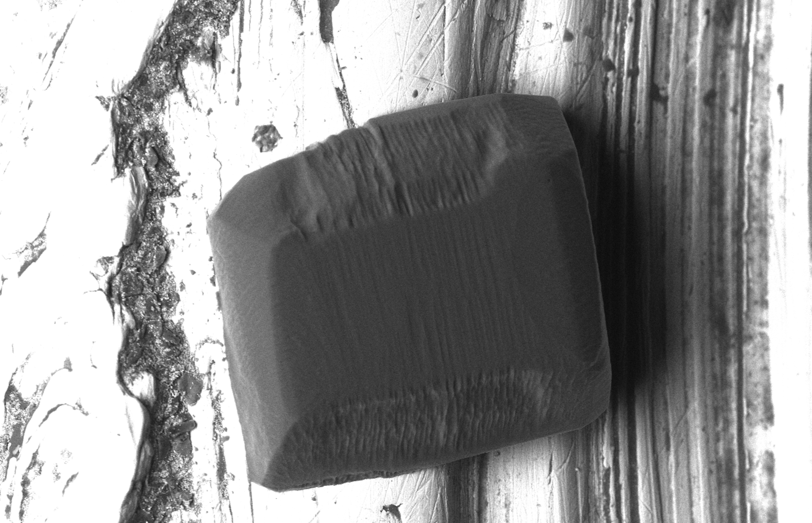
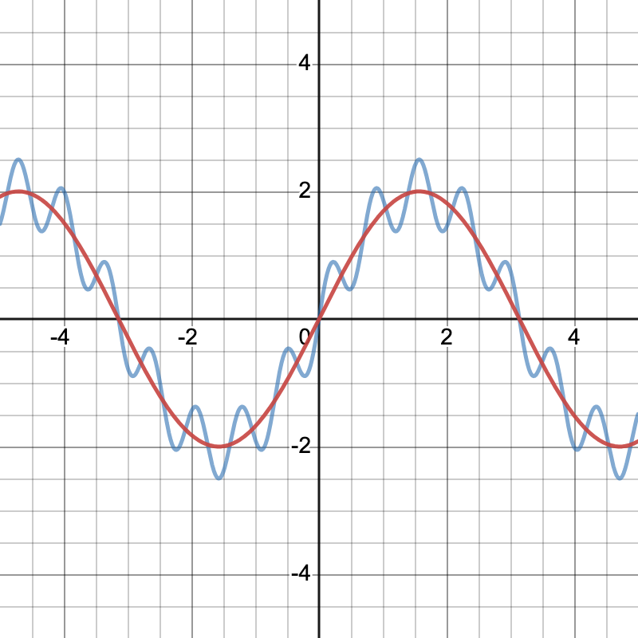
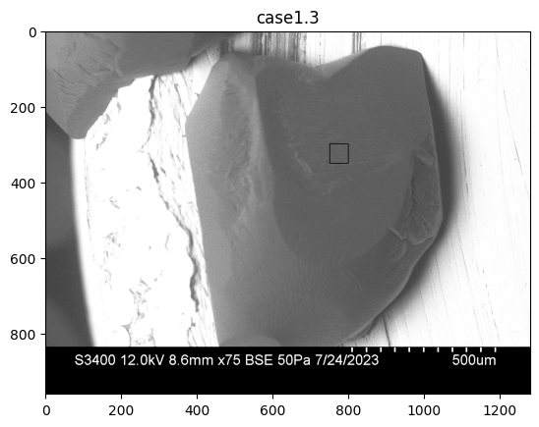
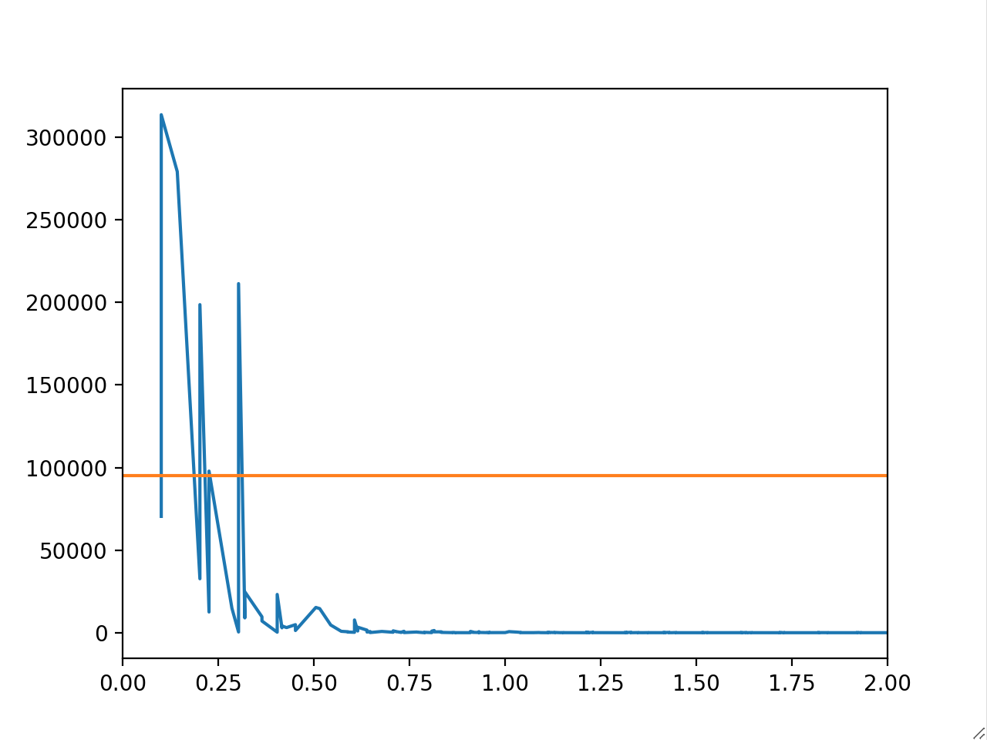
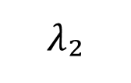
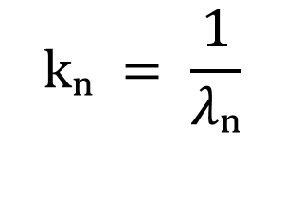
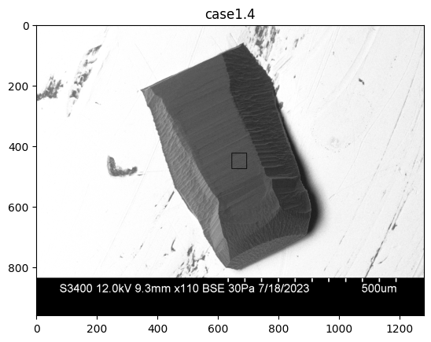
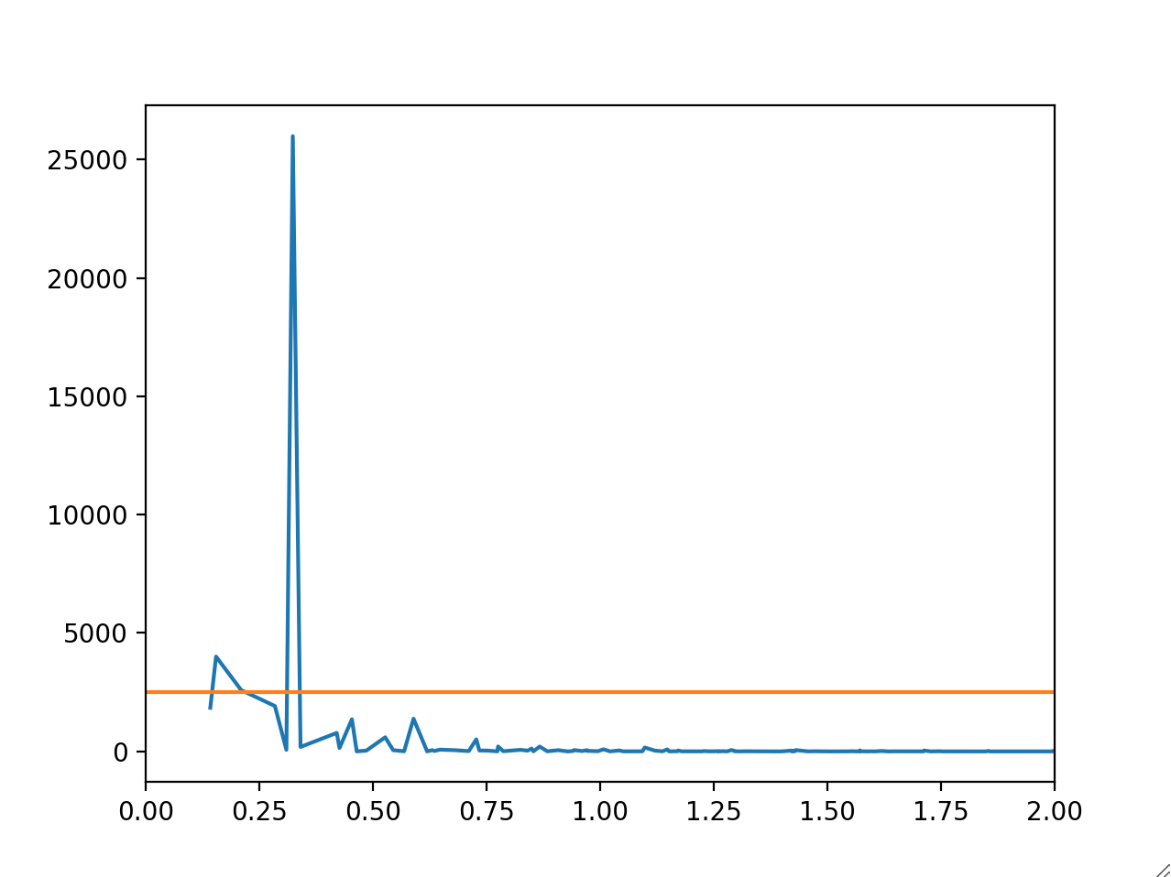
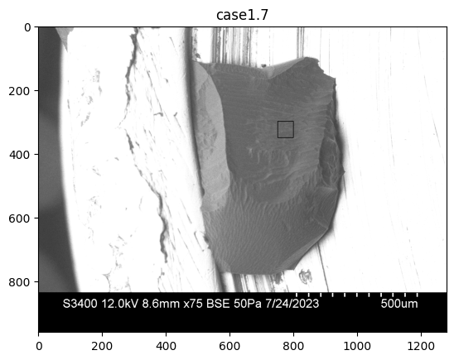
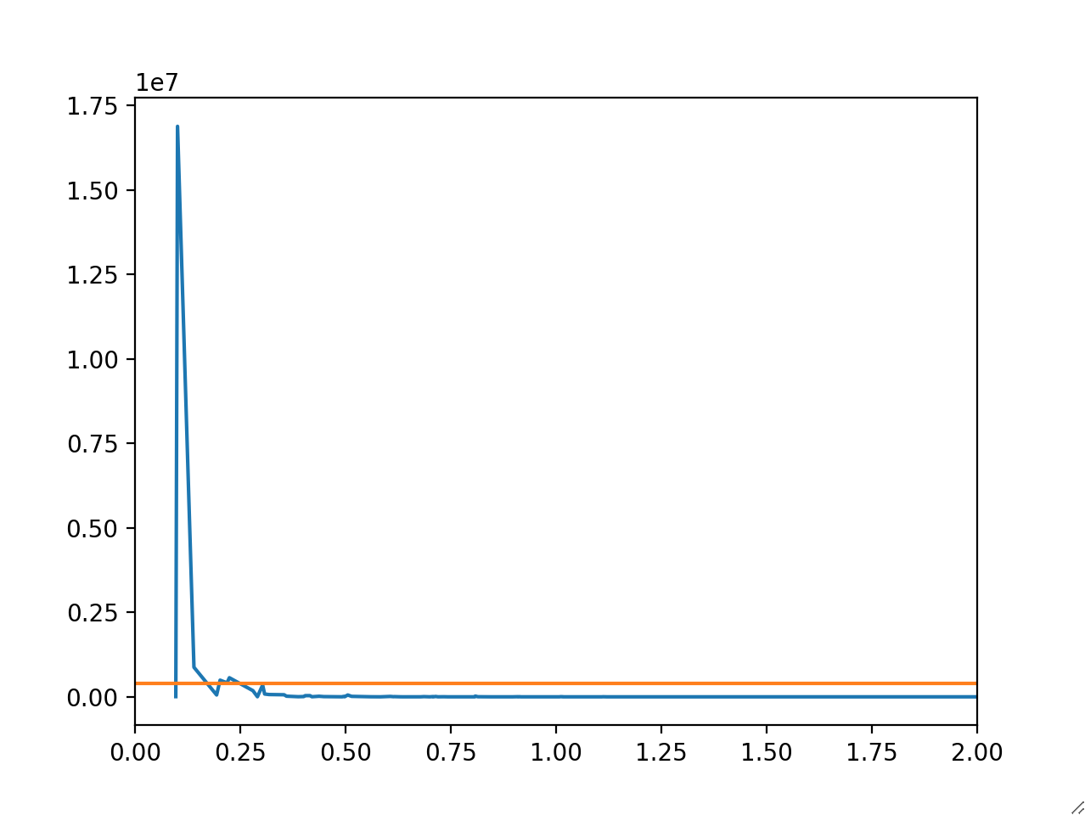
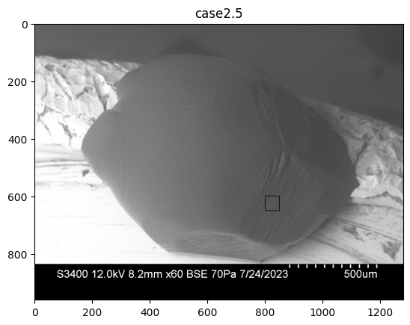
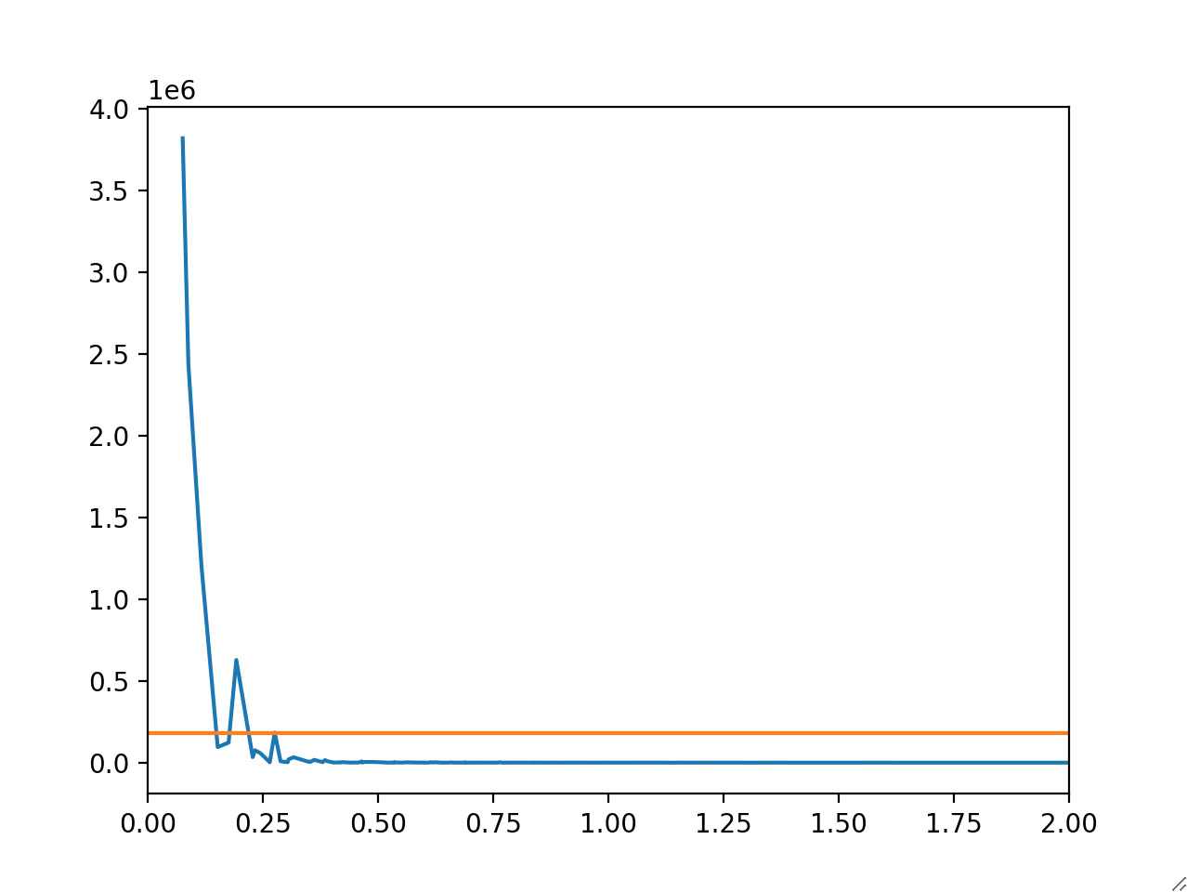
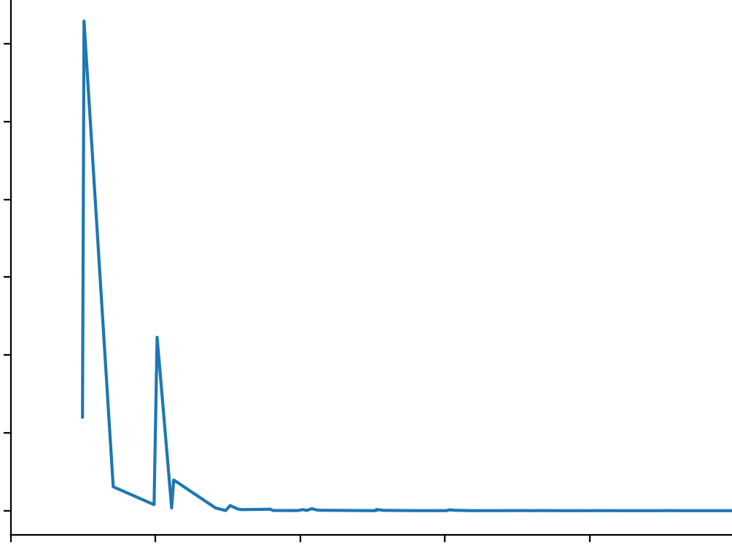
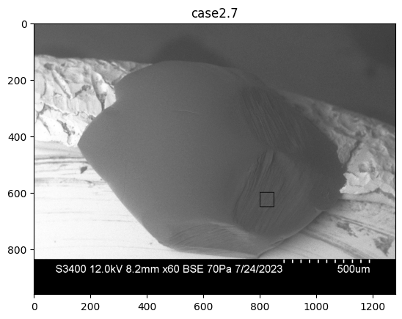
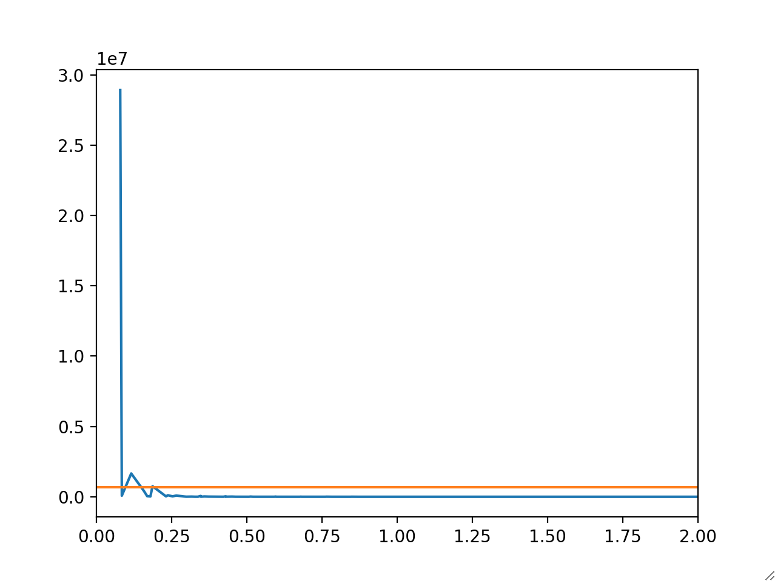
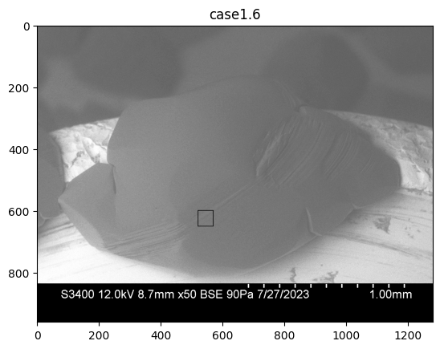
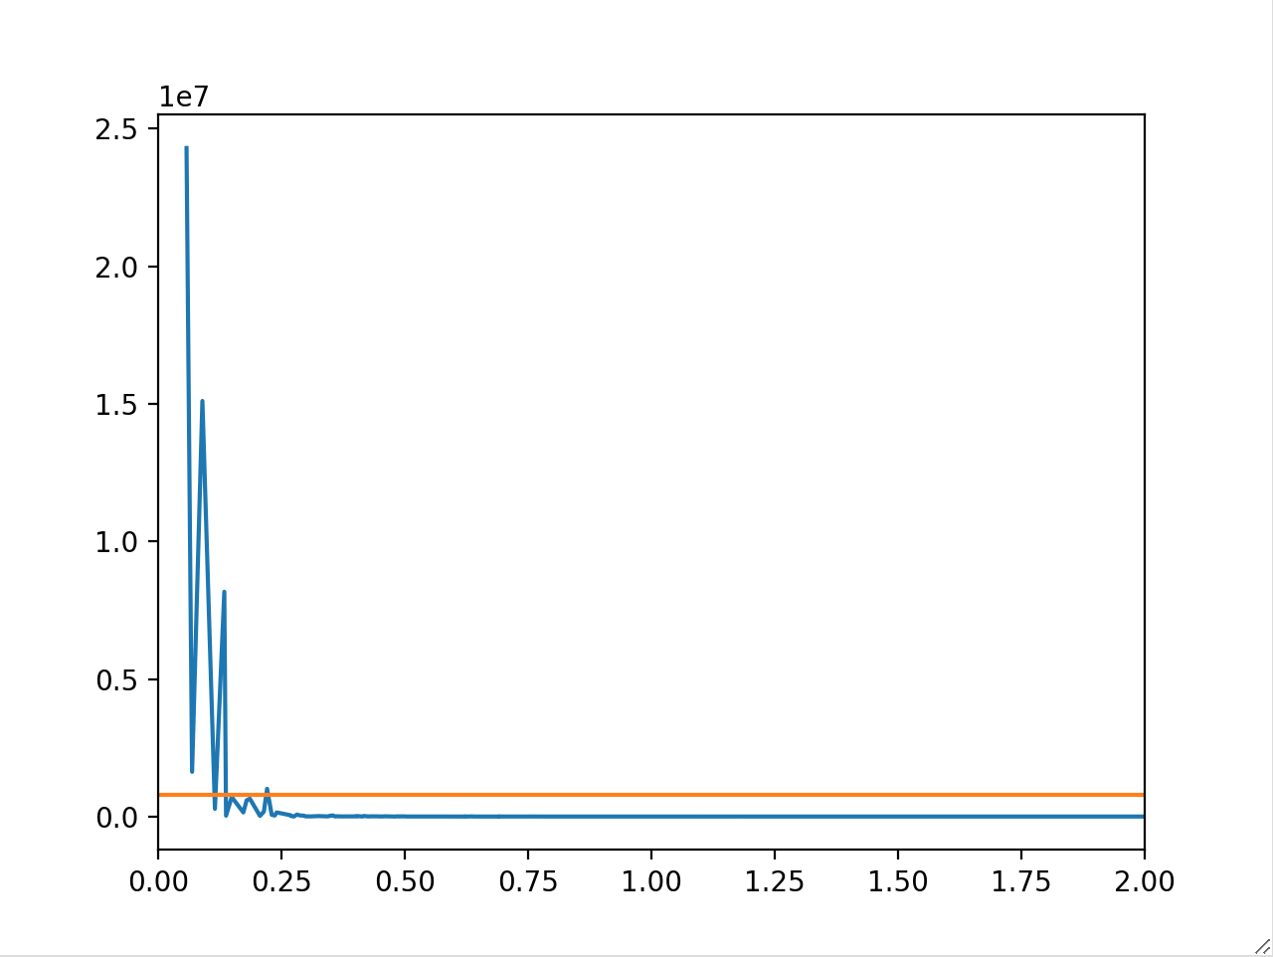
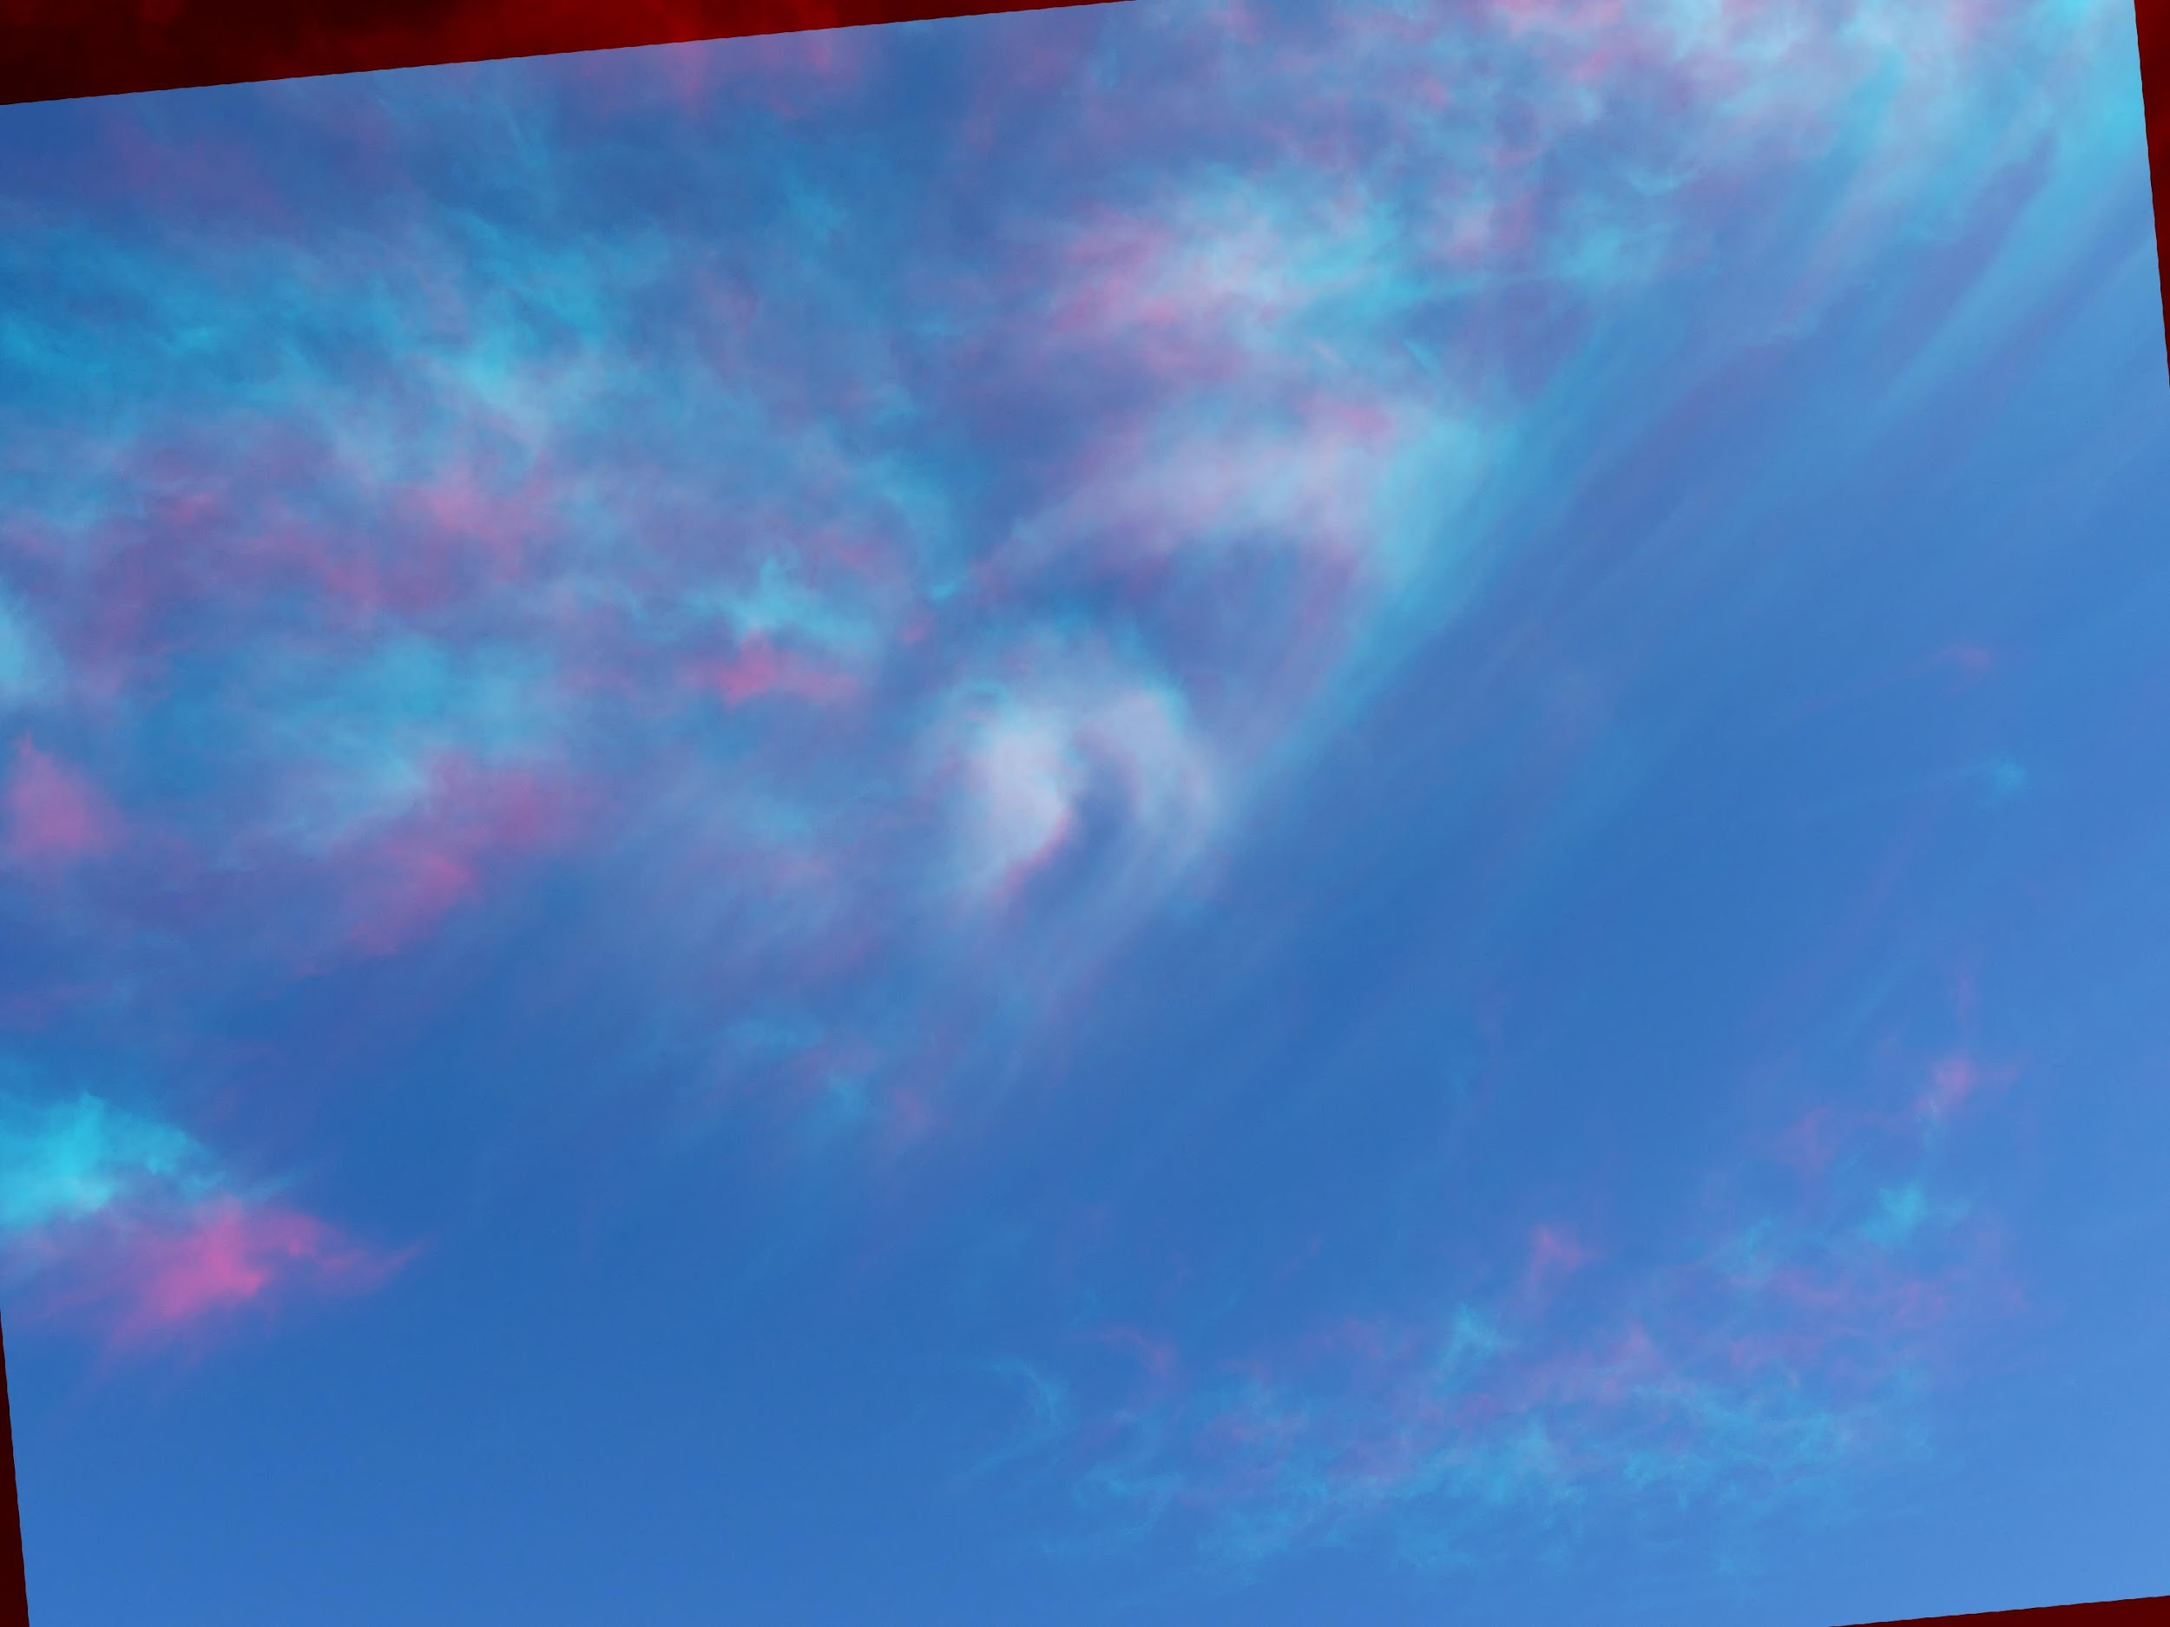
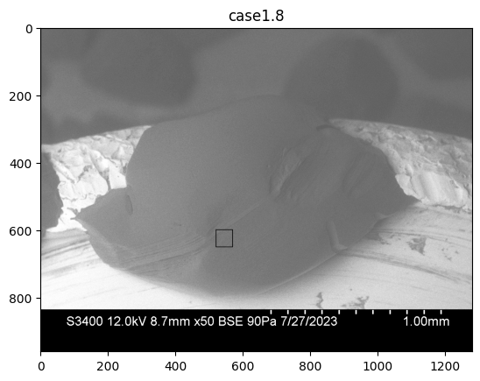
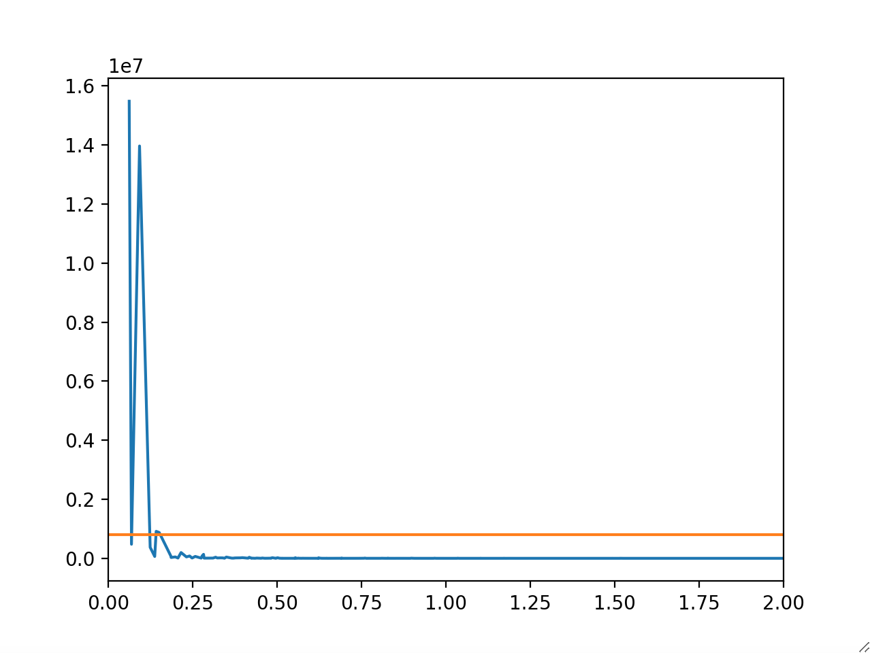
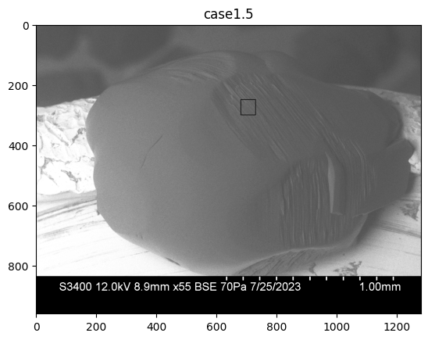
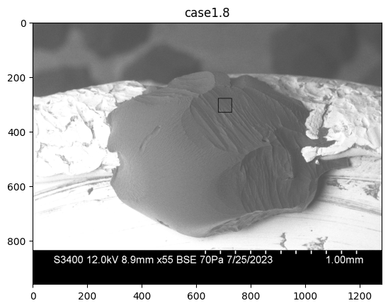

Characterizing the roughness of cirrus cloud ice crystals
Part 2
Rohan Crossland, Tia Böttger, Jake Price, Steven Neshyba; University of Puget Sound, Department of Mathematics
Analysis
Vapor Pressure (Pa)
Findings
The roughness we see on the prismatic facets consists of periodic fluctuations in the height.
We analyzed the roughness by taking the Fourier Transform of the height values for a whole segment.
30 Pa
Each column contains two images of the same crystal at the same pressure. The image on top was taken during crystal growth, while the one on the bottom was taken during ablation.
Roughness is analyzed within the box drawn on the crystal.
The temperature dependence of growth and ablation is consistent with the expected Clausius-Clapeyron relationship.
Clausius-Clapeyron Curve
Higher Altitudes
(colder)
Vapor pressure (Pa)
k₁ = 0.151
k₂ = 0.327
k₃ = 0.461
k₄ = 0.982
10
100
100,000
-34.0ºC
-40
Equilibrium
50 Pa
-20
Growth
k₁ = 0.101
k₂ = 0.202
k₃ = 0.226
k₄ = 0.303
Temperature (ºC)
-32.6ºC
Ablation
k₁ = 0.155
k₂ = 0.324
70 Pa
0
k₁
Smaller k values indicate more spacing between the peaks (λ₁), while larger k values represent tightly packed height oscillations (λ₂).
-30.8ºC
k₁ = 0.101
k₂ = 0.224
k₁ = 0.076
k₂ = 0.192
k₃ = 0.276
Increasing Temperature
-29.0ºC
-30.5ºC
k₂
90 Pa
The Fourier Transform produces a graph to show the amplitude of different frequencies.
The notable peaks in the graphs were then recorded and used to compare how the periodic fluctuations in the height change and develop under different temperature and pressure conditions.
-27.0ºC
k₁ = 0.079
k₂ = 0.116
k₃ = 0.187
-26.9ºC
k₁ = 0.058
k₂ = 0.090
k₃ = 0.134
k₄ = 0.221
Higher Altitudes
Increasing Temperature
View with 3D glasses!
Fig 7: 3D image showing the changing conditions of cirrus clouds. As gravity carries ice crystals from higher to lower elevation (shown in streaks), temperatures increase.
Lower Altitudes
(warmer)
-23.2ºC
k₁ = 0.062
k₂ = 0.093
k₃ = 0.142
Accomplishments
Lower Altitudes
This summer’s work included…
Capturing a total of 700 images from 41 unique crystals.
Updating and optimizing the code to calibrate crystals and analyze surface roughness.
Characterizing differences between growth roughness and ablation roughness on the prismatic facet.
Capturing real-time 3D images of cirrus clouds.
All of the crystal images and code can be viewed by scanning the QR code below!
Conclusions
Future Work
Major takeaways from this summer’s research include…
Further analysis to determine statistical significance between growth and ablation roughness.
Quantitative comparison of roughness on different crystal facets (basal, pyramidal, prismatic)
Trials at varying time scales to investigate the time dependence of roughness.
Retrieving relevant parameters in the literature to better understand how different types of roughness (e.g. growth and ablation) affect the way light reflects and scatters off the surface.
Continuing molecular dynamics simulations and differential equations model of faceted growth and how roughness arises through interactions of the quasi-liquid layer.
Continued work investigating whether roughness patterns may be explained by Turing instability theory.
2-dimension Fourier transformation of surface heights is an effective way to analyze roughness.
Rather than looking at roughness at each individual pixel, we can analyze roughness in terms of oscillations in surface height.
Initial results to support a difference between growth roughness and ablation roughness.
Growth roughness analysis consistently yields peaks with higher k values than those obtained from ablation roughness analysis. This translates to more spacing between the height oscillations found during ablation, and tightly packed oscillations during growth periods.
The phenomenon of faceted ice crystal ablation (crystal maintains geometry as it ablates), previously only hypothesized, has been clearly established.
Growth Roughness
Ablation Roughness
Notes:
Flow chart (SEM to code) with arrows that we smoothed out/ improved bottlenecks?

